Slide 1
Switching Execution Context

Slide 2
Operators provided by Reactive for Context Switching
publishOn
susbcribeOn
runOn

Slide 3
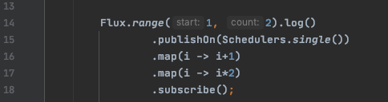
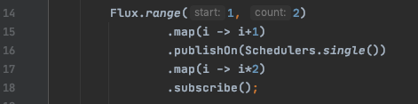
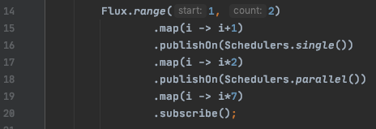
publishOn operator
Where you place the publishOn in the chain matters.
onSubscribe, onNext executed on Main method.
What ever downstream operations that are below the publishOn will be executed on Single Thread.

Slide 4
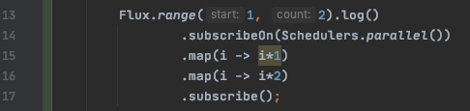
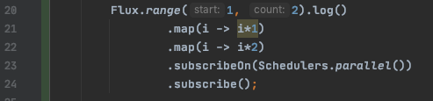
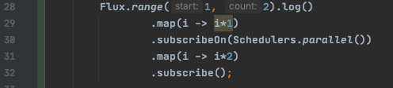
susbcribeOn operator
Where you place susbcribeOn does not matter unless you have publishOn in the chain.
In D1 susbcribeOn on TOP all even though all the Map operator will be executed on Parallel Thread.
In D2 susbcribeOn on BOTTOM even though all the Map operator will be executed on Parallel Thread.
In D3 susbcribeOn on MIDDLE even though all the Map operator will be executed on Parallel Thread.
D1
D2
D3

Slide 5
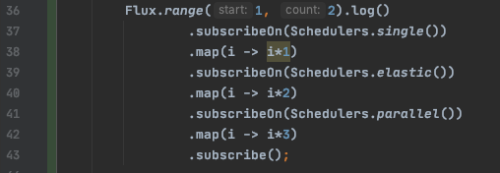
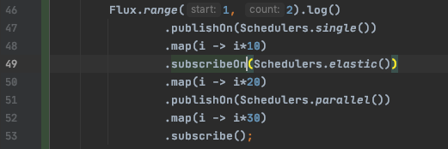
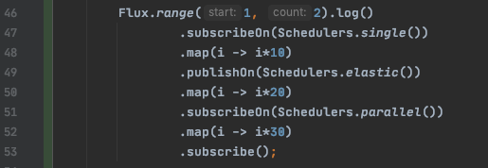
In D4 it has multiple susbcribeOn in the chain, in this case which ever the susbcribeOn closer to source(i.e near to Flux) will be executed.
D4
In D5
Map1 function be executed by Single thread
Map2 function be executed by Single thread, since publishOn dominates the susbcribeOn.
Map3 function be executed by parallel thread.
In D6
Map1 function be executed by Single thread
Map2 function be executed by Elastic.
Map3 function be executed by Elastic, since publishOn dominates the susbcribeOn.
publishOn always dominate the susbcribeOn
D5
D6

Slide 6
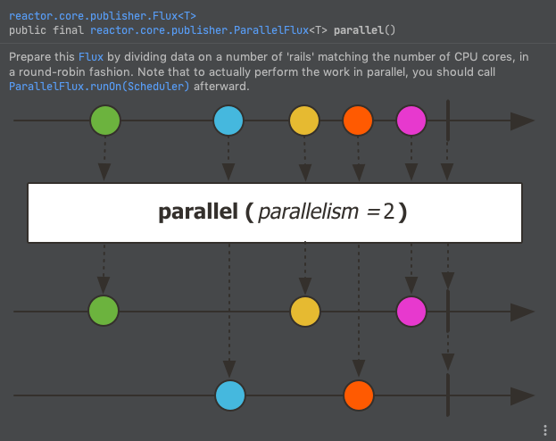
parallel Operator
is the Perpetuities for runOn operator
Parallel is the method in Flux class.
This method converts Flux to parallel Flux.
It divide the Flux into multiple flux depends on the CPU core.
If you have 4 core CPU then it divide the Flux into 4 different Flux.
It also overloaded method that takes integer as parameter. Depends on the input parameter it divide the Flux to respective input.
Note:
runOn method can be used only on Parallel flux.

Slide 7
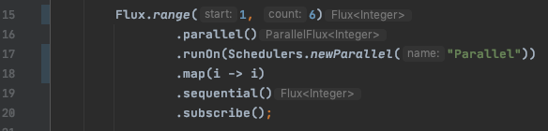
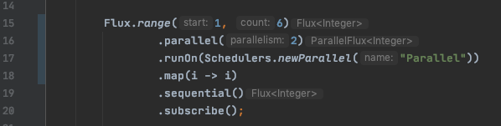
runOn Operator
runOn can be applied only on parallel Flux.
Initially the Flux has 6 elements in D1 and D2.
In D1 parallel operator divide the Flux into multiple flux depends on CPU core.
In D2 parallel operator divide the Flux into 2 different Flux.
1st Flux will contain 1, 2 and 3 elements.
2nd Flux will contain 4, 5 and 6 elements.
Then runOn method will be applied for all the Flux after the split is completed.
D1
D2

